Slide 1

Software Engineering & Project Management
Prof. Yashwant Dongre
Yashwant.dongre@viit.ac.in
Department of Computer Engineering
BRACT’S, Vishwakarma Institute of Information Technology, Pune-48
(An Autonomous Institute affiliated to Savitribai Phule Pune University)
(NBA and NAAC accredited, ISO 9001:2015 certified)

Slide 2
Objective/s of this session
1.
2.
3.
1.
2.
3.
Learning Outcome/Course Outcome
Prof. Yashwant Dongre, Department of Computer Engineering, VIIT , Pune-48

Slide 3
Contents
Generic Process Model
Prescriptive Process Model
Waterfall Model
Incremental Process (RAD) Model
Evolutionary Process Model
Unified Process Model
Concurrent Model
Prof. Yashwant Dongre, Department of Computer Engineering, VIIT , Pune-48

Slide 4
A Layered Technology
Software Engineering
tools
methods
process model
a “quality” focus

Slide 5
Quality Focus
TQM, Six Sigma gives continuous process improvement culture.
Leads to the development of increasingly more effective approaches to software engineering
Prof. Yashwant Dongre, Department of Computer Engineering, VIIT , Pune-48

Slide 6
Process
Glue that holds the technology layers together.
Enables rational & timely development of computer software.
Defines framework that must be established for effective delivery of software engineering technology.
Forms the basis for management control of software projects.
Establishes the context in which technical methods are applied, work products are produced, milestones are established, quality is ensured, change is properly managed.
Prof. Yashwant Dongre, Department of Computer Engineering, VIIT , Pune-48

Slide 7
Methods
Provide the technical “how to’s “ for building software.
Encompass a broad array of tasks that include communication, requirement analysis, design modeling, construction, testing, support.
Prof. Yashwant Dongre, Department of Computer Engineering, VIIT , Pune-48

Slide 8
Tools
Provide automated or semi-automated support for the process and the methods.
Integration of tools
Information is shared
Prof. Yashwant Dongre, Department of Computer Engineering, VIIT , Pune-48

Slide 9
A Process Framework
Process framework
  Framework activities
    work tasks
    work products
    milestones & deliverables
    QA checkpoints
  Umbrella Activities
Prof. Yashwant Dongre, Department of Computer Engineering, VIIT , Pune-48

Slide 10
Framework Activities
Communication
Planning
Modeling
  Analysis of requirements
  Design
Construction
  Code generation
  Testing
Deployment
Prof. Yashwant Dongre, Department of Computer Engineering, VIIT , Pune-48

Slide 11
Umbrella Activities
Software project management
Formal technical reviews
Software quality assurance
Software configuration management
Work product preparation and production
Reusability management
Measurement
Risk management
Prof. Yashwant Dongre, Department of Computer Engineering, VIIT , Pune-48

Slide 12
The Process Model: Adaptability
the framework activities will always be applied on every project but the tasks for each activity will vary based on:
  the type of project
  characteristics of the project
  common sense judgment; concurrence of the project team
Prof. Yashwant Dongre, Department of Computer Engineering, VIIT , Pune-48

Slide 13
Process Patterns
Process patterns define a set of activities, actions, work tasks, work products and/or related behaviors
A template is used to define a pattern
Typical examples:
  Customer communication (a process activity)
  Analysis (an action)
  Requirements gathering (a process task)
  Reviewing a work product (a process task)
  Design model (a work product)
Prof. Yashwant Dongre, Department of Computer Engineering, VIIT , Pune-48

Slide 14
Personal Software Process (PSP)
Recommends five framework activities:
  Planning
  High-level design
  High-level design review
  Development
  Postmortem
Stresses the need for each software engineer to identify errors early and as important, to understand the types of errors
Prof. Yashwant Dongre, Department of Computer Engineering, VIIT , Pune-48

Slide 15
Purpose
To build computer software.
Process may be haphazard, ad-hoc, may change on daily basis, may not be efficient, effective.
Emphasizes personal measurement of both the work product that is produced and resultant quality of the work product.
Makes practitioner’s responsible for project planning (estimating & scheduling)
Empowers that practitioner to control the quality of all software work products are developed.
Prof. Yashwant Dongre, Department of Computer Engineering, VIIT , Pune-48

Slide 16
Disadvantage
Not widely adopted throughout the industry.
Have more to do with human nature and organizational inertia than strengths & weaknesses of PSP approach.
Intellectually challenging & demands a level of commitment that is not always possible to obtain.
Training is lengthy, training cost is high,
The required level of measurement is culturally difficult for many software people.
Prof. Yashwant Dongre, Department of Computer Engineering, VIIT , Pune-48

Slide 17
Team Software Process (TSP)
Each project is “launched” using a “script” that defines the tasks to be accomplished
Teams are self-directed
Measurement is encouraged
Measures are analyzed with the intent of improving the team process
Prof. Yashwant Dongre, Department of Computer Engineering, VIIT , Pune-48

Slide 18
Purpose
Build a self-directed project team that organizes itself to produce high quality software.
A self directed team has a consistent understanding of its overall goals & objectives.
It defines roles & responsibilities for each team member; tracks quantitative project data; identify a team process that is appropriate for project & a strategy for implementing the process; defines local standards; assesses risk; tracks, manages, reports project status.
Prof. Yashwant Dongre, Department of Computer Engineering, VIIT , Pune-48

Slide 19
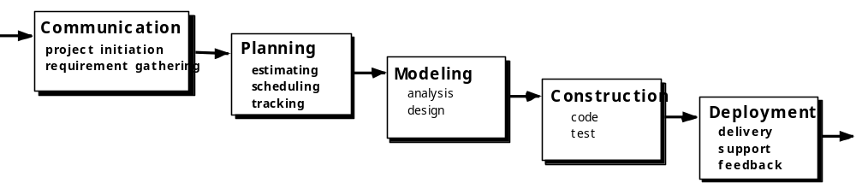
The Waterfall Model
Prof. Yashwant Dongre, Department of Computer Engineering, VIIT , Pune-48

Slide 20
Theory
Systematic and sequential approach to software development.
Classic life cycle model
Model mandates that each phase will be executed after completion of the previous phase
Prof. Yashwant Dongre, Department of Computer Engineering, VIIT , Pune-48

Slide 21
Advantages
Simplicity
Logical structuring of the different activities in a software project
Model is perfect for projects where requirements are very well defined.
Prof. Yashwant Dongre, Department of Computer Engineering, VIIT , Pune-48

Slide 22
Disadvantages
It is strict about moving only one step at a time. This is to ensure that the complete project is moving together.
Customer has difficulty expressing requirements in their entirely.
Has difficulty accommodating natural uncertainty that exists at the beginning of the cycle.
Model does not allow capturing potential risk in the project.
A working version of the software is not available until late in the process.
Prof. Yashwant Dongre, Department of Computer Engineering, VIIT , Pune-48

Slide 23
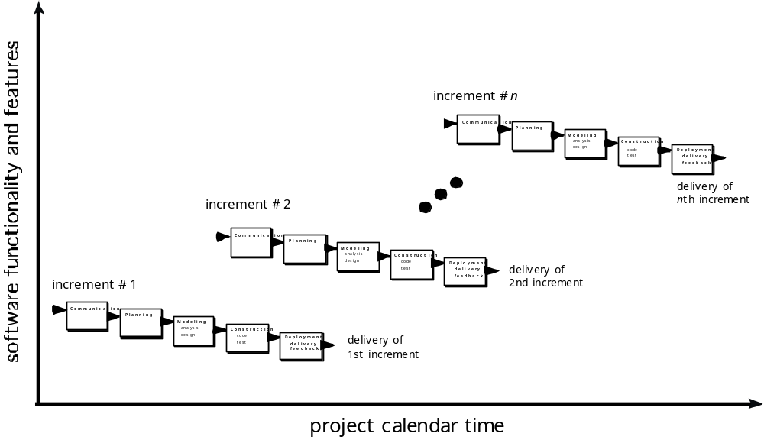
The Incremental Model
Prof. Yashwant Dongre, Department of Computer Engineering, VIIT , Pune-48

Slide 24
Theory
Combines elements of the waterfall model applied in iterative manner.
Applies linear sequences in a staggered fashion as calendar time progresses.
Each linear sequence produces deliverable increments of the software. E.g. word processing software.
Focuses on the delivery of an operational product with each increment.
Prof. Yashwant Dongre, Department of Computer Engineering, VIIT , Pune-48

Slide 25
Advantages
Useful when staffing is unavailable.
Prof. Yashwant Dongre, Department of Computer Engineering, VIIT , Pune-48

Slide 26
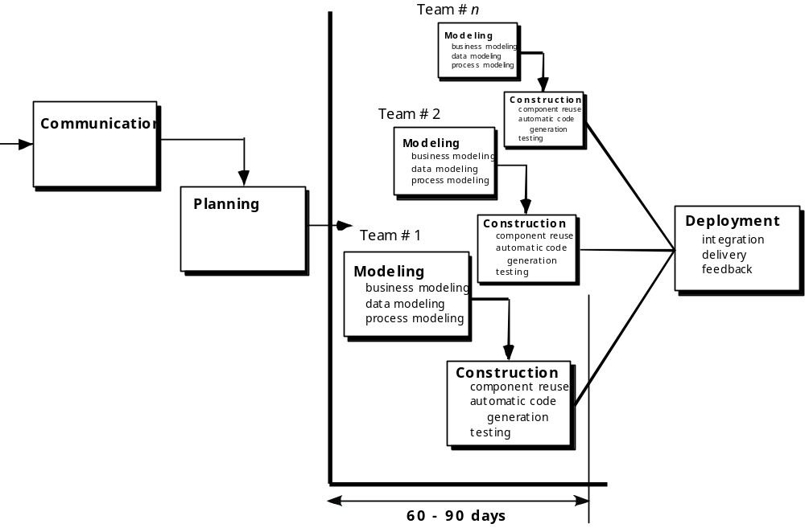
The RAD Model
Prof. Yashwant Dongre, Department of Computer Engineering, VIIT , Pune-48

Slide 27
Theory
Rapid Application Development
It is recommended where there are tight deadlines and high pressure from customer
Emphasizes on short development cycle
Each major function can be addressed by a separate RAD team followed by the integration of the separately developed functionalities
Necessitates the involvement of users throughout the development life cycle
Prof. Yashwant Dongre, Department of Computer Engineering, VIIT , Pune-48

Slide 28
Advantages
Provides quick time to market.
Fully functional system is expected within a short time of say 60 to 90 days.
Prof. Yashwant Dongre, Department of Computer Engineering, VIIT , Pune-48

Slide 29
Disadvantages
It requires sufficient human resources to create the right number of RAD teams.
Prof. Yashwant Dongre, Department of Computer Engineering, VIIT , Pune-48

Slide 30

Evolutionary Models: Prototyping
Prof. Yashwant Dongre, Department of Computer Engineering, VIIT , Pune-48

Slide 31
Theory
Iterative approach to software development
Useful when either the customer or the developer is unsure of the exact requirements of the software.
Throw-way Model: Discard the model once all requirements are understood.
Evolving Model: Refine the model every time when the requirements are clearer.
Prof. Yashwant Dongre, Department of Computer Engineering, VIIT , Pune-48

Slide 32
Advantages
Minimizing technical risks.
Prof. Yashwant Dongre, Department of Computer Engineering, VIIT , Pune-48

Slide 33
Disadvantages
It may lead to indiscipline of development
Prof. Yashwant Dongre, Department of Computer Engineering, VIIT , Pune-48

Slide 34
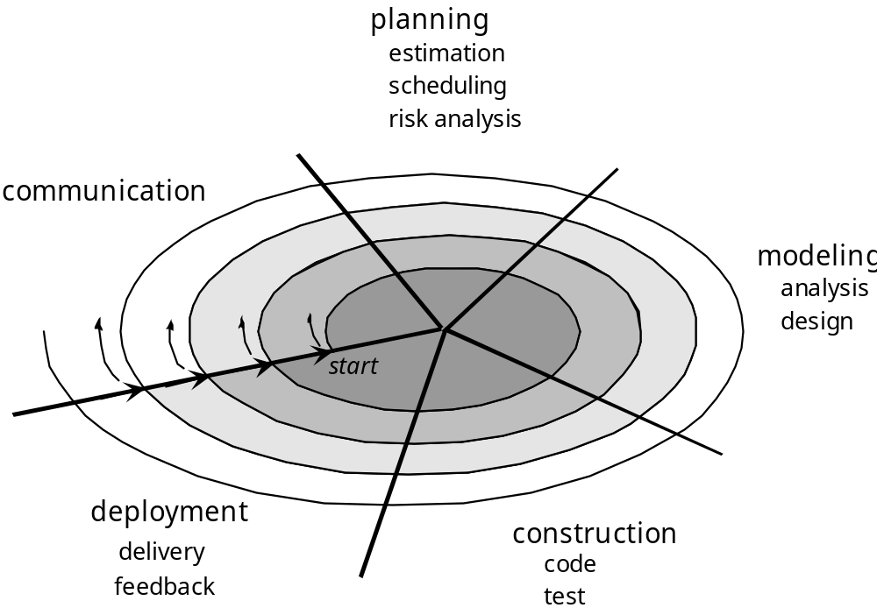
Evolutionary Models: The Spiral
Prof. Yashwant Dongre, Department of Computer Engineering, VIIT , Pune-48

Slide 35
Theory
Meta Model for software development processes.
Model couples the iterative nature of the prototyping model and the controlled, systematic aspect of the waterfall model.
It is evolutionary software process model.
Prof. Yashwant Dongre, Department of Computer Engineering, VIIT , Pune-48

Slide 36
Advantages
Introduces the element of risk analysis.
It is more realistic because real world engineering requires considerable iteration.
Prof. Yashwant Dongre, Department of Computer Engineering, VIIT , Pune-48

Slide 37
Disadvantages
It requires considerable expertise in terms of risk assessment and project management.
Prof. Yashwant Dongre, Department of Computer Engineering, VIIT , Pune-48

Slide 38
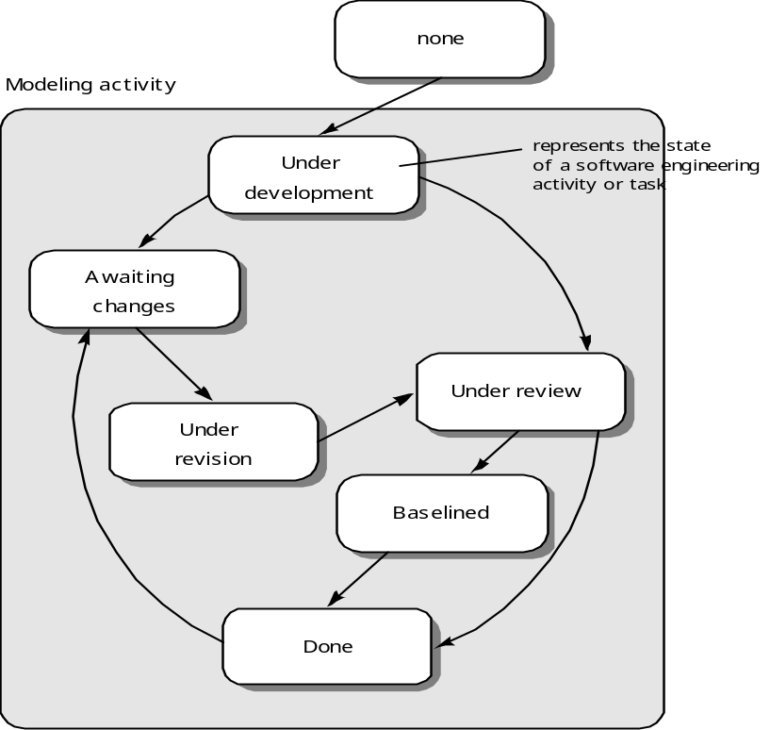
Evolutionary Models: Concurrent
Prof. Yashwant Dongre, Department of Computer Engineering, VIIT , Pune-48

Slide 39
Instructions/Guidelines/References
1.
2.
3.
4.
Prof. Yashwant Dongre, Department of Computer Engineering, VIIT , Pune-48

Slide 40
Wrap up and related outcomes
1.
2.
3.
4.
Prof. Yashwant Dongre, Department of Computer Engineering, VIIT , Pune-48

Slide 41
To be discussed next time
Part –I
Engineering as a Profession.. How does it different from other profession?
Roles and responsibilities of engineers
Significance of ethics in engineering
Part-II
Code of Ethical conduct for an engineer
Ethics, Law and Moral form engineers perspective
Case studies/examples of ethical reasoning …closely related to business ethics
Part-III
E-mail Etiquettes
Telephone Etiquettes
Social Etiquettes
Prof. Yashwant Dongre, Department of Computer Engineering, VIIT , Pune-48

Slide 42
Thank You
Prof. Yashwant Dongre, Department of Computer Engineering, VIIT , Pune-48

